Slide 1
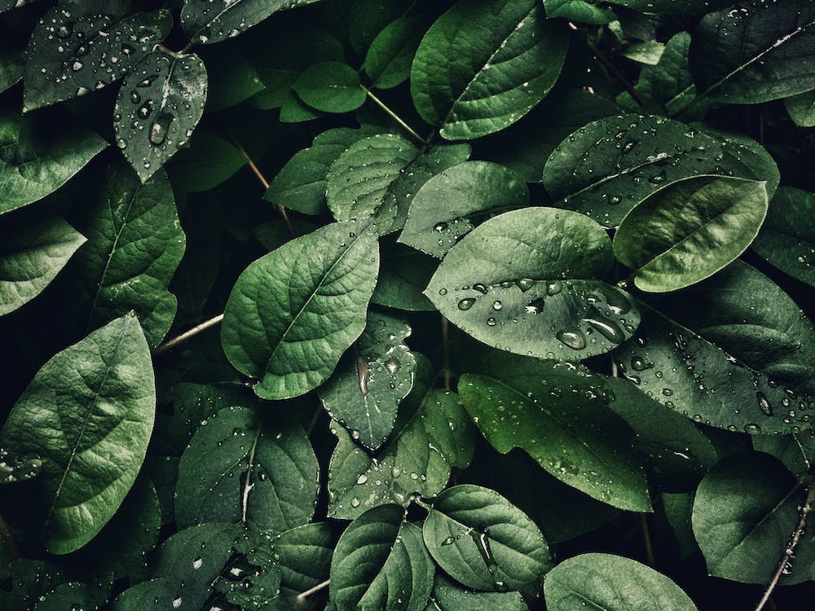

Slide 2
Identification of medicinal plants using Deep learning

Slide 3
TEAM MEMBERS
A. SATYANARAYANA
(210701235)
K.S.J.SNEHA
(210701253)
M.PURUSHOTHAMAN
(210701199)

Slide 4
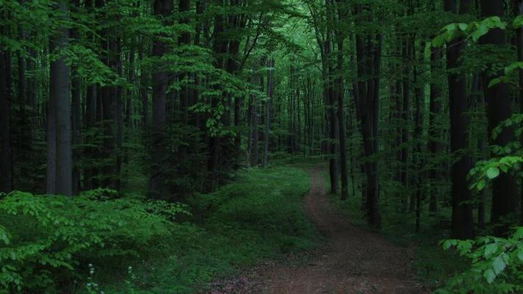
INTRODUCTION
Medicinal plants have played an integral role in people’s lives especially with the growing interest in Ayurveda and Natural remedies which bring about little to no side effects. Since ancient times, people have always turned to medicinal plants for therapeutic and medicinal values along with their potential health benefits. Identification of these medicinal plants may bring about a safe and effective way of using these plants to harbor the desired effect. Using deep learning by leveraging the power of transfer learning with EfficientNetV2 architecture, we make this process efficient and accurate. Specifically, Convolutional Neural Networks (CNNs) are utilized to detect these medicinal plants accurately. Unlike traditional methods, which may be laborious and prone to errors, our approach harnesses the efficiency and accuracy of deep learning.

Slide 5
INTRODUCTION
Medicinal plants have played an integral role in people’s lives especially with the growing interest in Ayurveda and Natural remedies which bring about little to no side effects. Since ancient times, people have always turned to medicinal plants for therapeutic and medicinal values along with their potential health benefits. Identification of these medicinal plants may bring about a safe and effective way of using these plants to harbor the desired effect. Using deep learning by leveraging the power of transfer learning with EfficientNetV2 architecture, we make this process efficient and accurate. Specifically, Convolutional Neural Networks (CNNs) are utilized to detect these medicinal plants accurately. Unlike traditional methods, which may be laborious and prone to errors, our approach harnesses the efficiency and accuracy of deep learning.

Slide 6
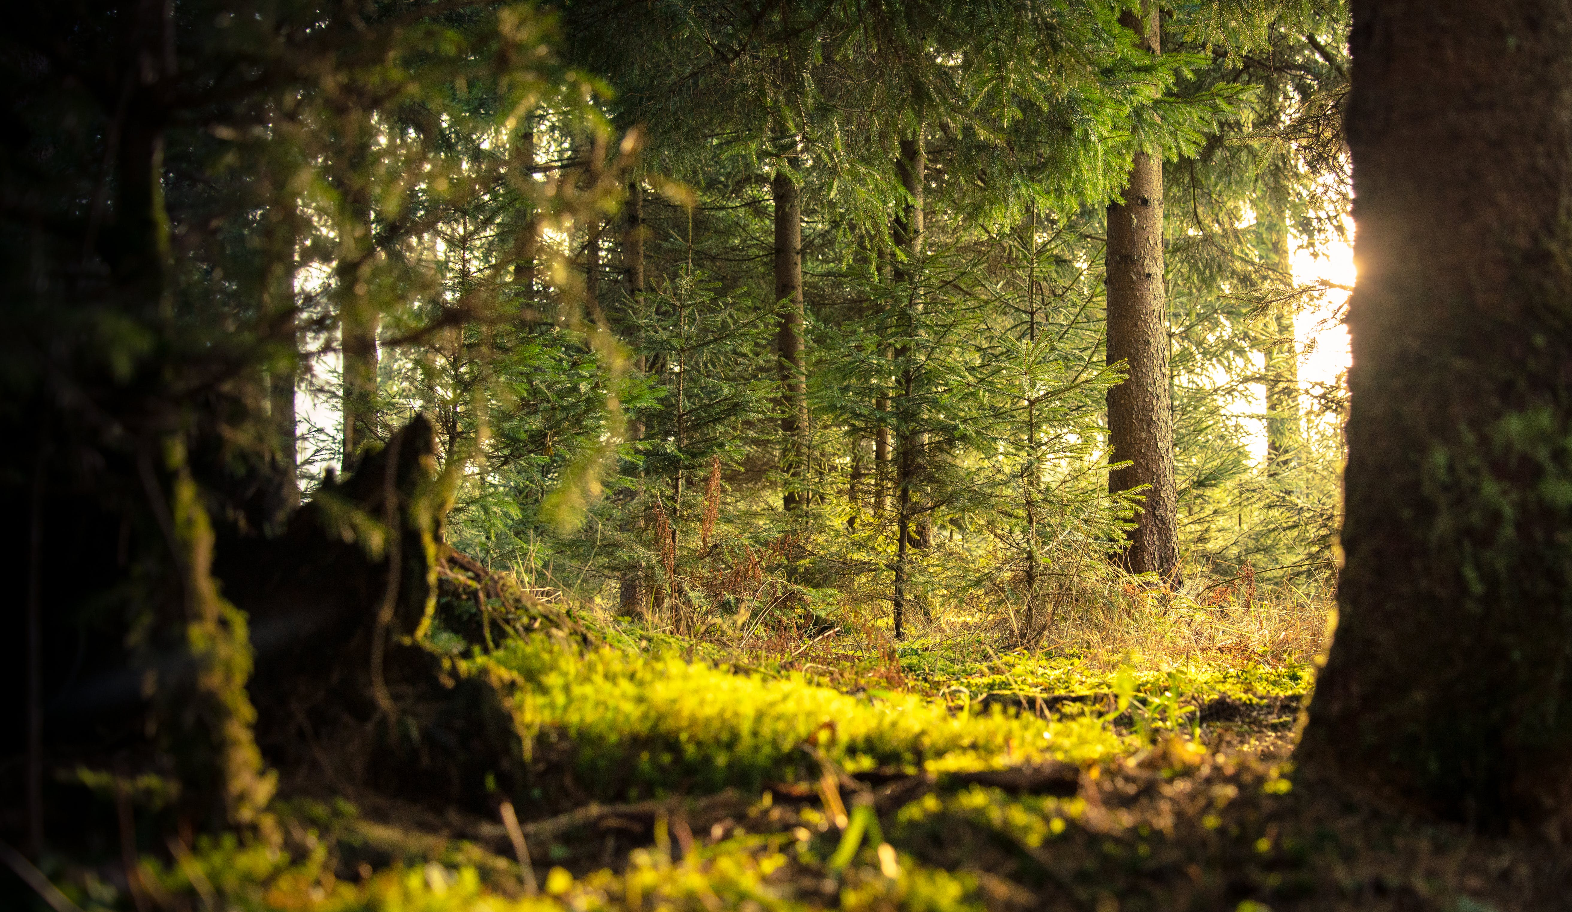
ABSTRACT

Slide 7
Project utilizes transfer learning with EfficientNetV2 architecture for plant classification.
Extensive data preprocessing: resizing, normalization, and augmentation for optimal input.
Convolutional Neural Network (CNN) trained on preprocessed image data for high accuracy.
Flask-based backend API for seamless model deployment and integration.
Users can upload images and receive precise predictions via the API.
Integration of data augmentation techniques like rotation, shearing, and flipping.
React-based frontend for user-friendly image uploading and result visualization.
Holistic approach ensures accurate plant classification and intuitive interface.
Effective and user-friendly for various plant classification and identification applications.
ABSTRACT

Slide 8
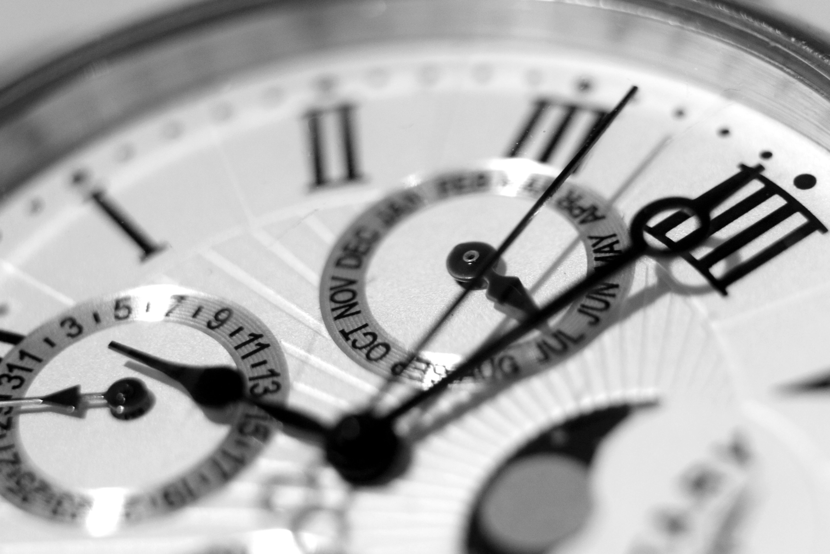



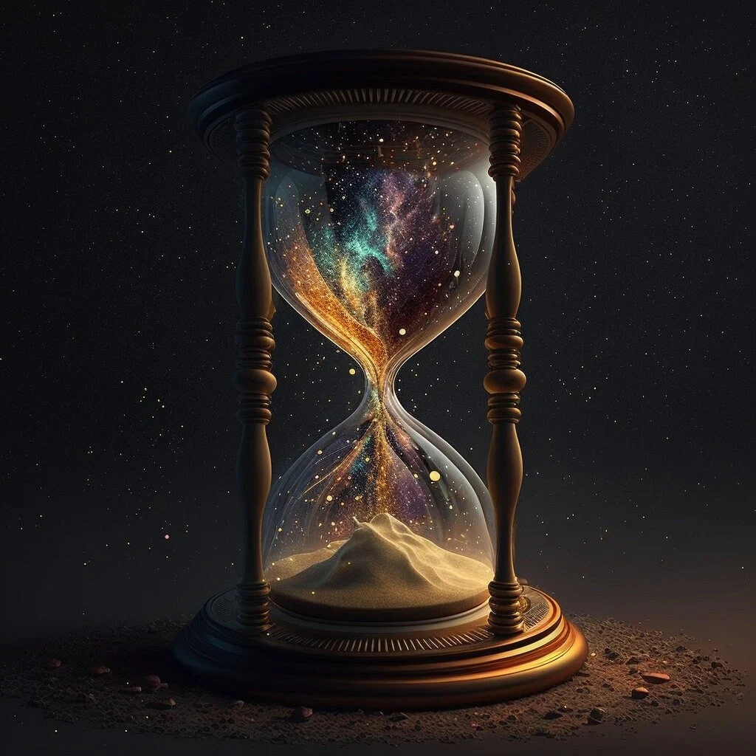
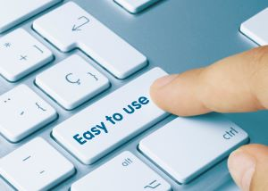

OBJECTIVES

Slide 9

ACCURATE PLANT CLASSIFICATION
OBJECTIVES
Develop a system capable of accurately classifying different plant species based on input images.

Slide 10
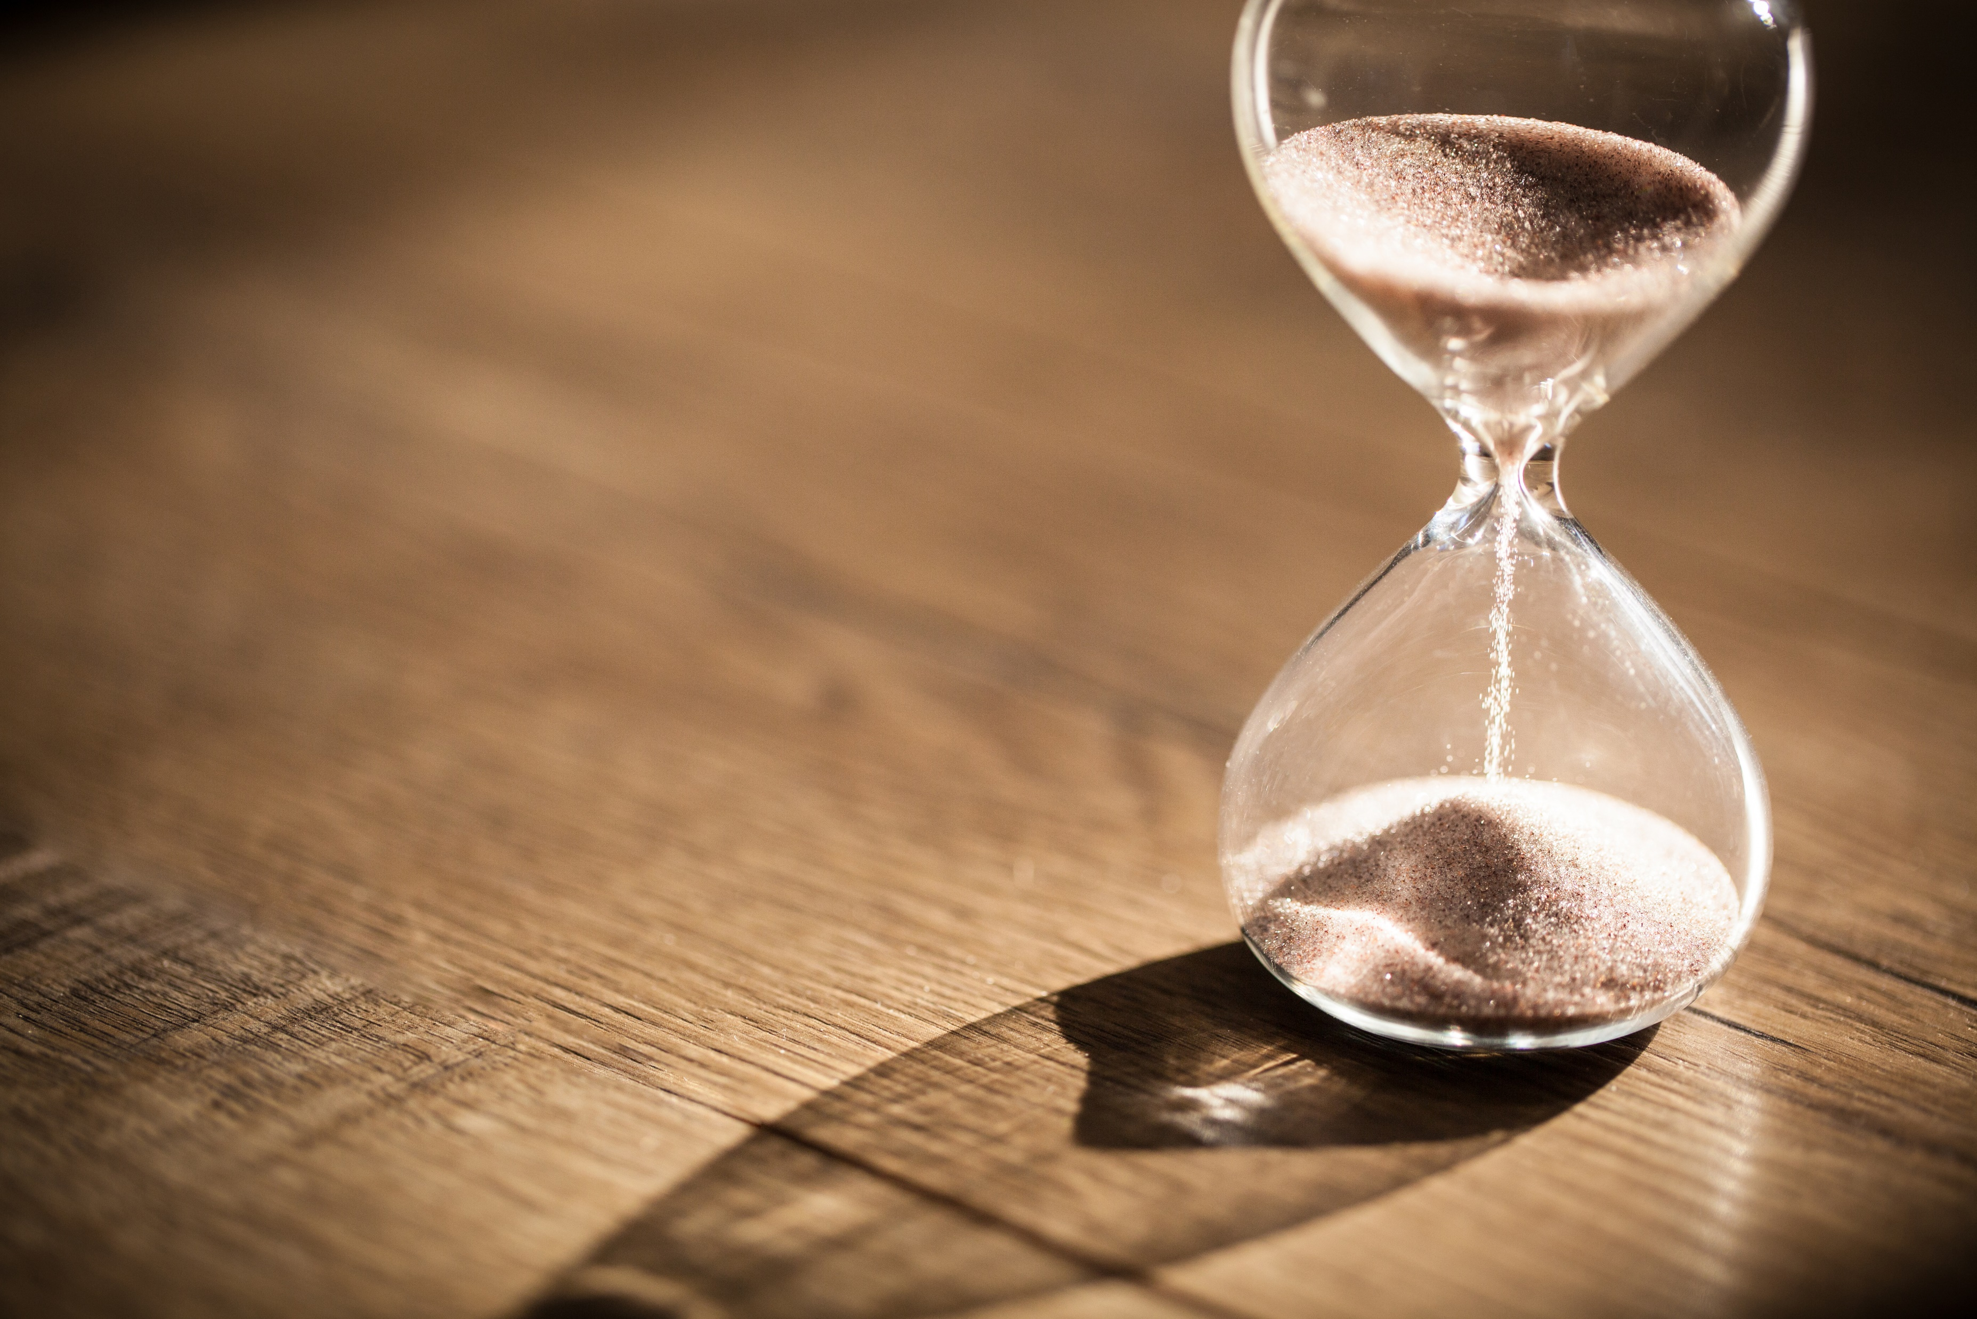
EFFICIENT MODEL TRAINING
OBJECTIVES
Implement transfer learning techniques to leverage pre-trained models for efficient and effective training on limited datasets.

Slide 11

SCALABLE BACKEND
Build a scalable backend using Flask to deploy the trained model as an API, allowing seamless integration with various frontend applications.
OBJECTIVES

Slide 12

USER-FRIENDLY FRONTEND
OBJECTIVES
Develop a user-friendly frontend interface using React to facilitate easy image uploading and result visualization.

Slide 13

ROBUST PERFORMANCE
Ensure the system's robust performance by implementing data preprocessing and augmentation techniques to handle variations in input images effectively.
OBJECTIVES

Slide 14
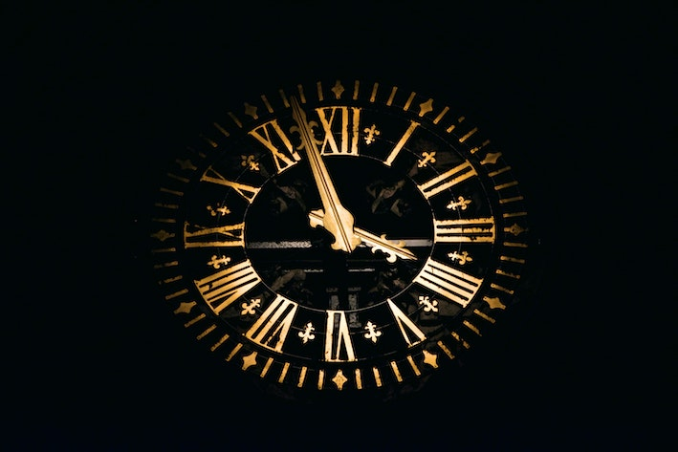
REAL-TIME PREDICTIONS
OBJECTIVES
Enable real-time predictions, allowing users to receive classification results quickly and accurately.

Slide 15

ENHANCED MODEL
GENERALISATION
OBJECTIVES
Implement data augmentation methods to improve the model's generalization ability, enabling it to classify unseen images effectively.

Slide 16
OBJECTIVES

Slide 17
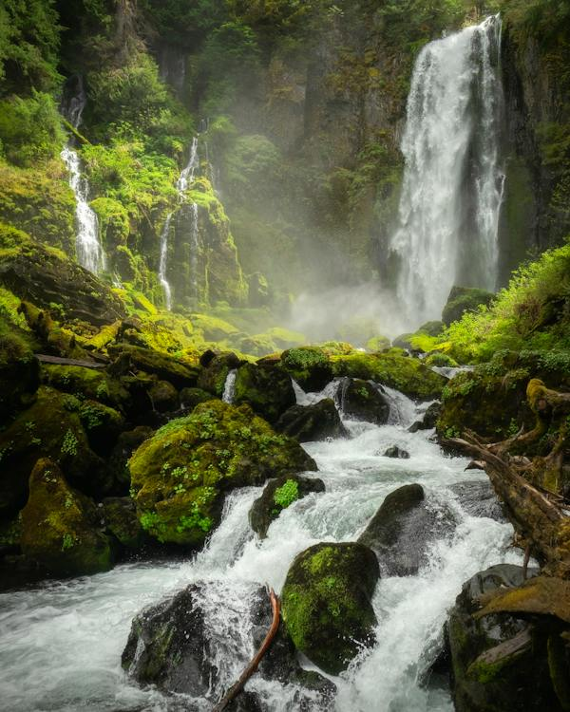
PROBLEM
STATEMENT

Slide 18
Developing a robust image classification system for identifying plant species, including medicinal plants, using deep learning techniques. The system aims to accurately classify various plant species based on images, contributing to applications in agriculture, botany, environmental conservation, and medicinal research.
PROBLEM
STATEMENT

Slide 19

PROPOSED
EXISTING
SYSTEM
1. Manual identification
2. General-purpose tools
3. Lack of specialized expertise
4. Reliability concerns
5. Need for specialized solutions
1.Machine learning-based identification
2. Enhanced accuracy and reliability
3. Authentication functionality
4.Customized training. 5. User-friendly interface
6. Integration with frontend

Slide 20
EXISTING
PROPOSED
SYSTEM
1. Manual identification
2. General-purpose tools
3. Lack of specialized expertise
4. Limited authentication capabilities
5. Reliability concerns
6. Need for specialized solutions
1.Deep learning-based identification
2. Enhanced accuracy and reliability
3. Customized training 4. User-friendly interface
5. Scalable backend

Slide 21
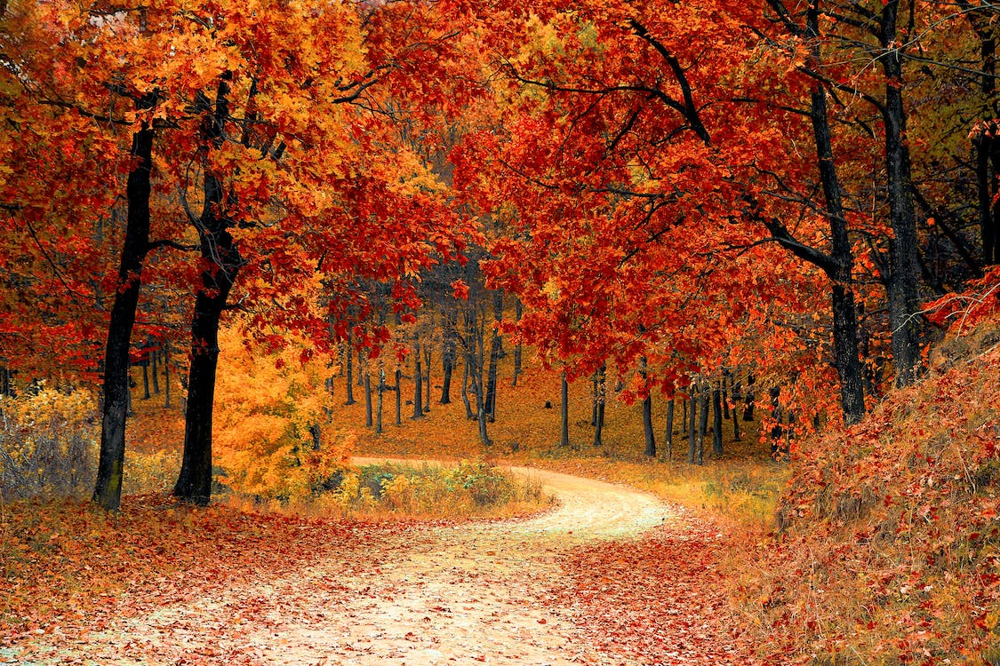
MODULES
USED

Slide 22
MODULES USED
Image Upload
Preprocessing
Model loading
API Call
Prediction

Slide 23
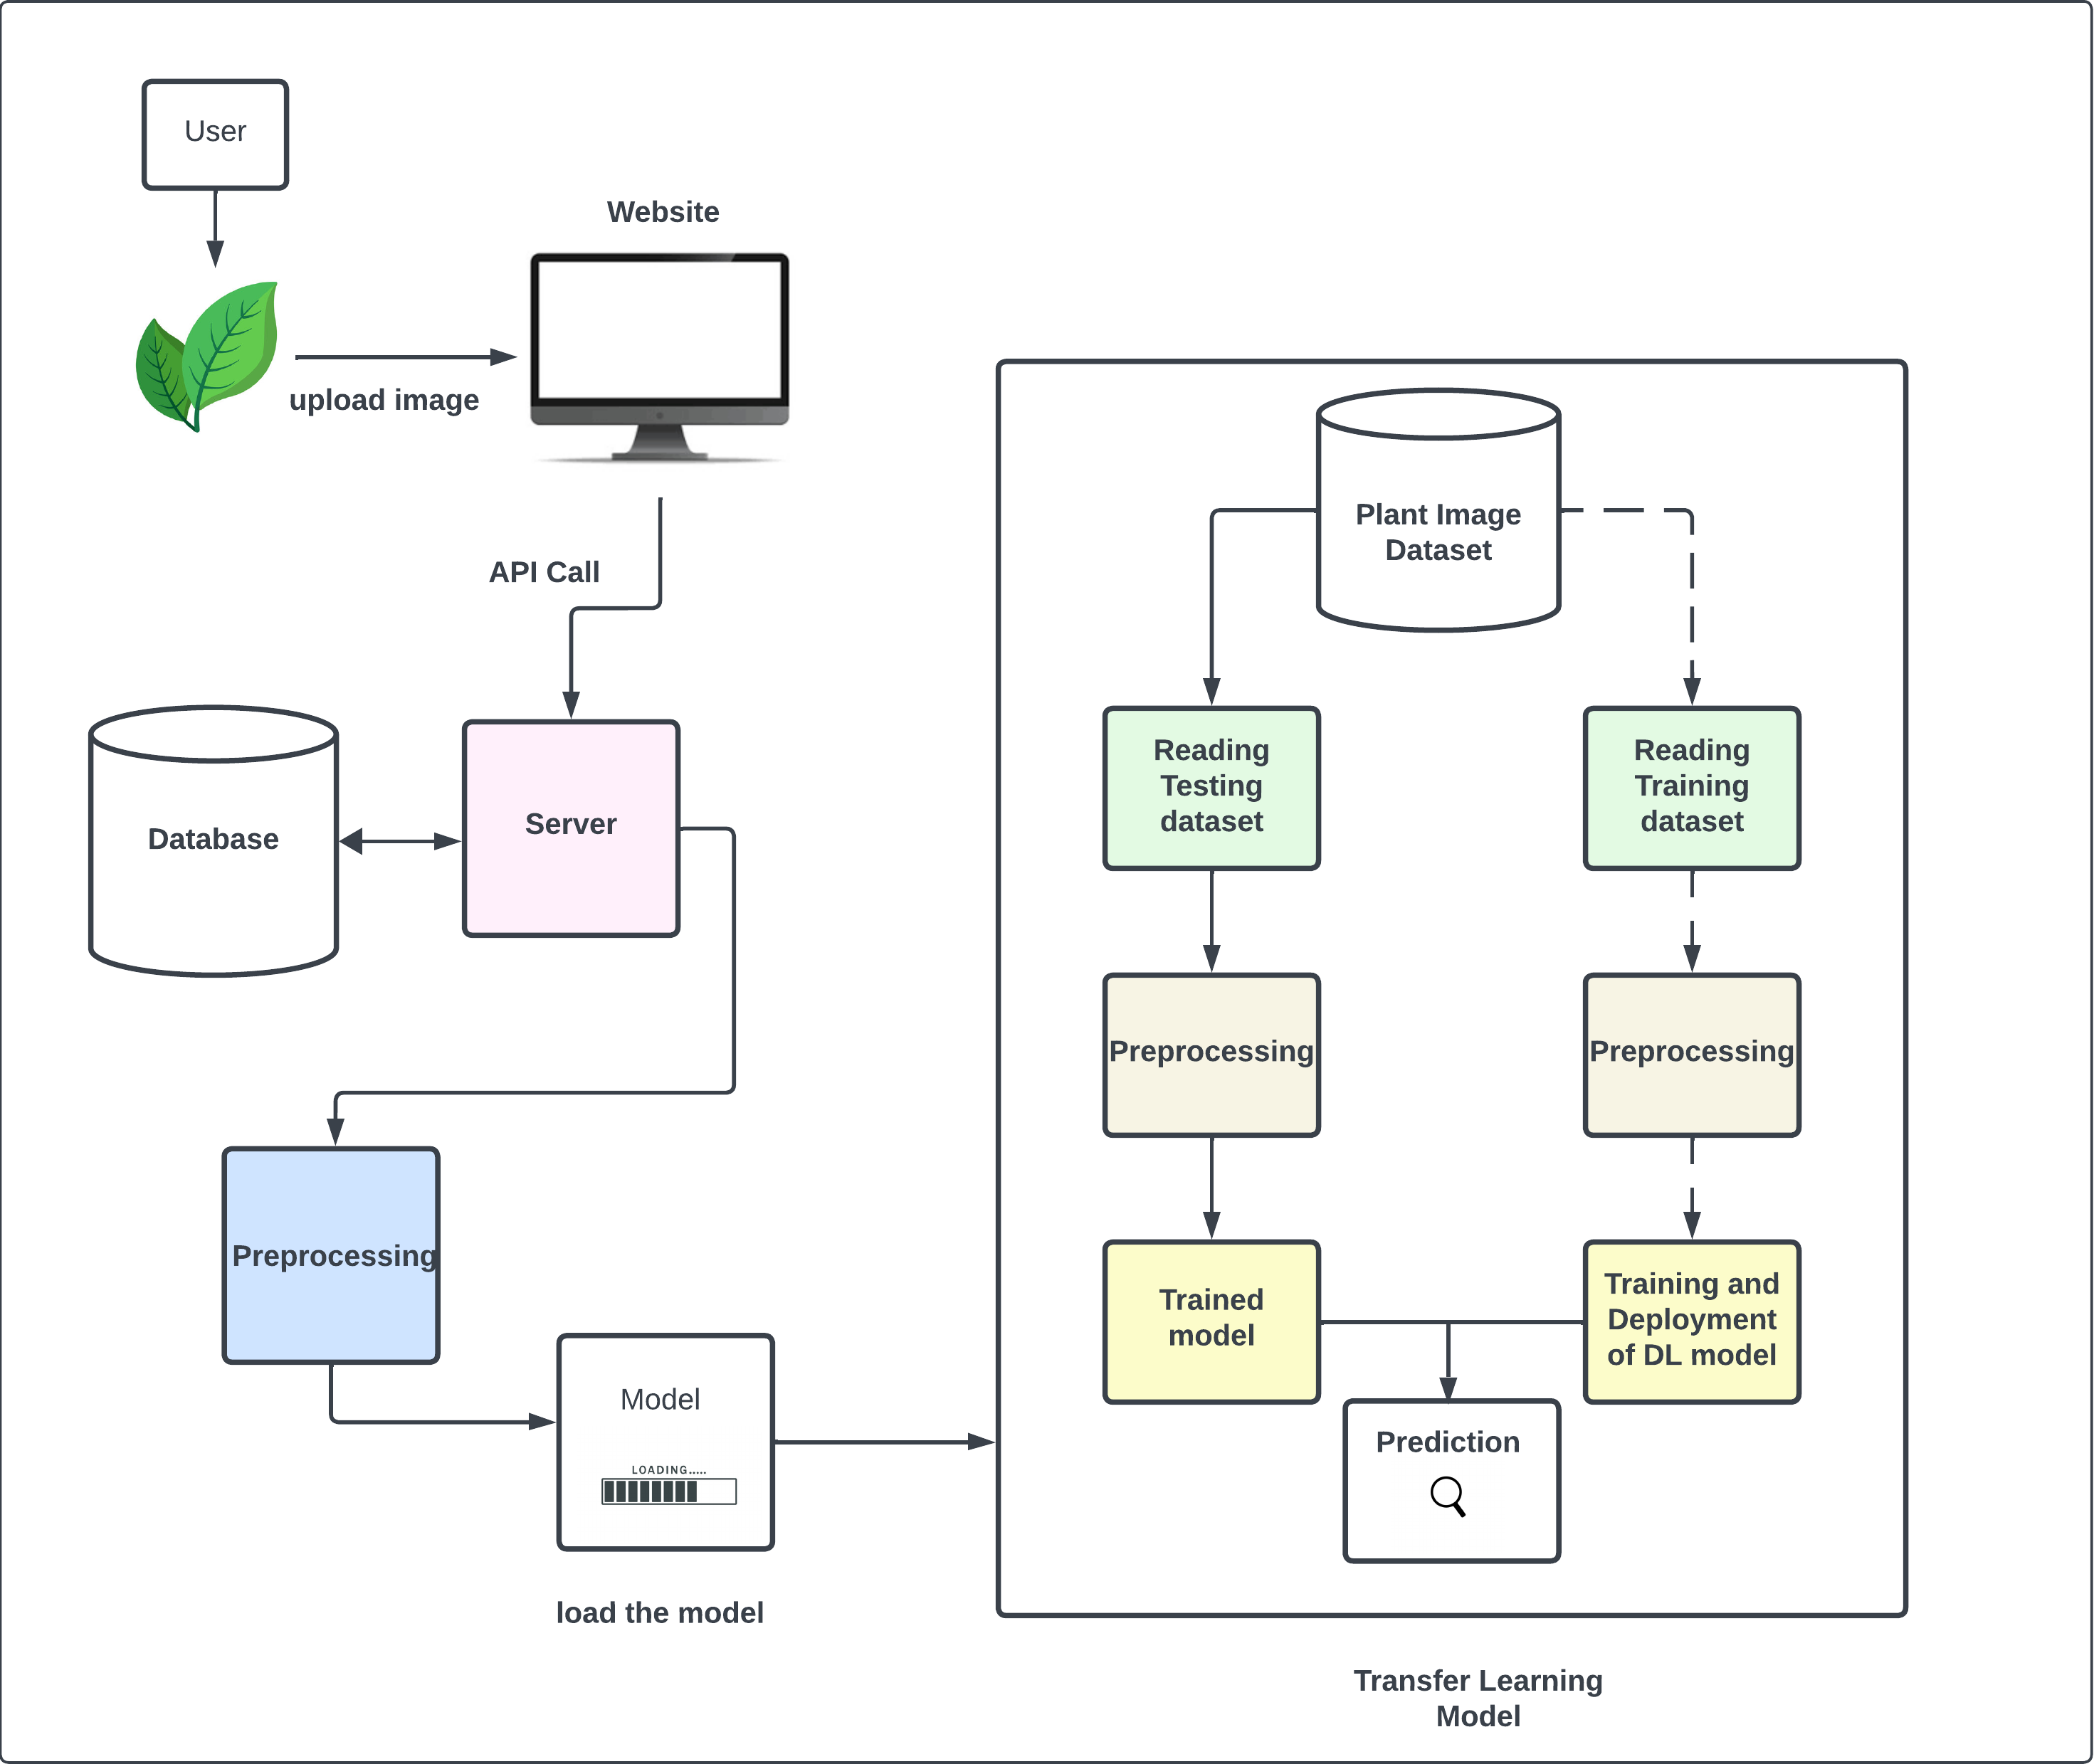
SYSTEM ARCHITECTURE

Slide 24







TECHNOLOGIES USED
REACTJS
React is a JavaScript library for building user interfaces. It is used to create the frontend application where users can interact with the system by uploading images of medicinal plants.

Slide 25
TECHNOLOGIES USED
FLASK
Flask is a lightweight web framework for building web applications in Python. It is used to create the backend API that handles image processing requests and serves the results back to the frontend.

Slide 26
TECHNOLOGIES USED
TENSORFLOW
TensorFlow is an open-source machine learning framework, and Keras is an API for building and training deep learning models. They are used for developing and training the machine learning model to identify medicinal plants.

Slide 27
TECHNOLOGIES USED
TENSORFLOW HUB
TensorFlow Hub is a repository of pre-trained machine learning models. It is used to access pre-trained models, such as the EfficientNetV2 architecture, for feature extraction in the machine learning model.

Slide 28
TECHNOLOGIES USED
NUMPY
NumPy is a Python library for numerical computing. It is used for numerical operations and data manipulation within the machine learning model.

Slide 29
TECHNOLOGIES USED
SCIKIT-LEARN
Scikit-learn is a Python library for machine learning. It is used for additional machine learning functionalities such as data preprocessing and model evaluation.

Slide 30

OUTPUT
SCREENSHOTS

Slide 31
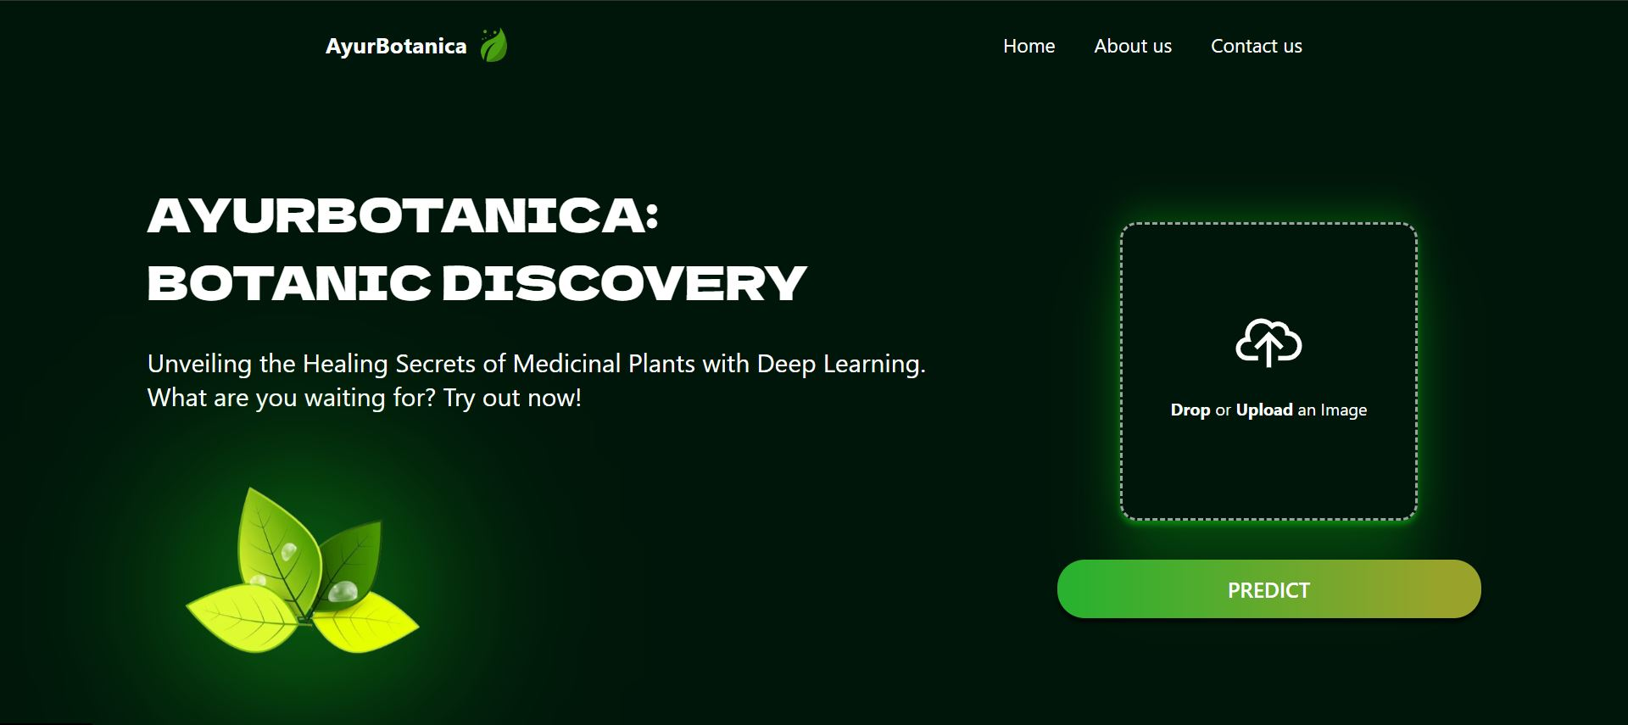

Slide 32
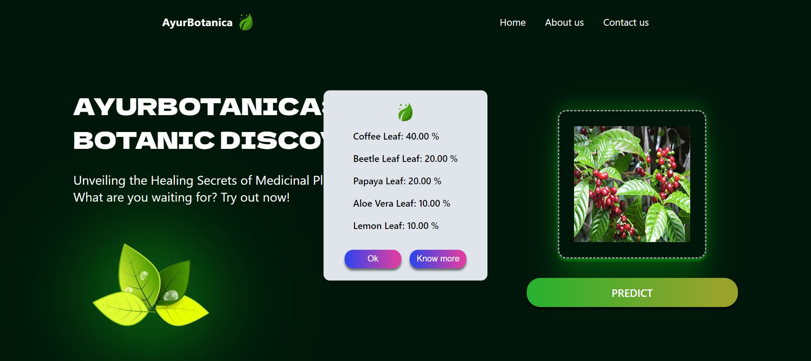

Slide 33
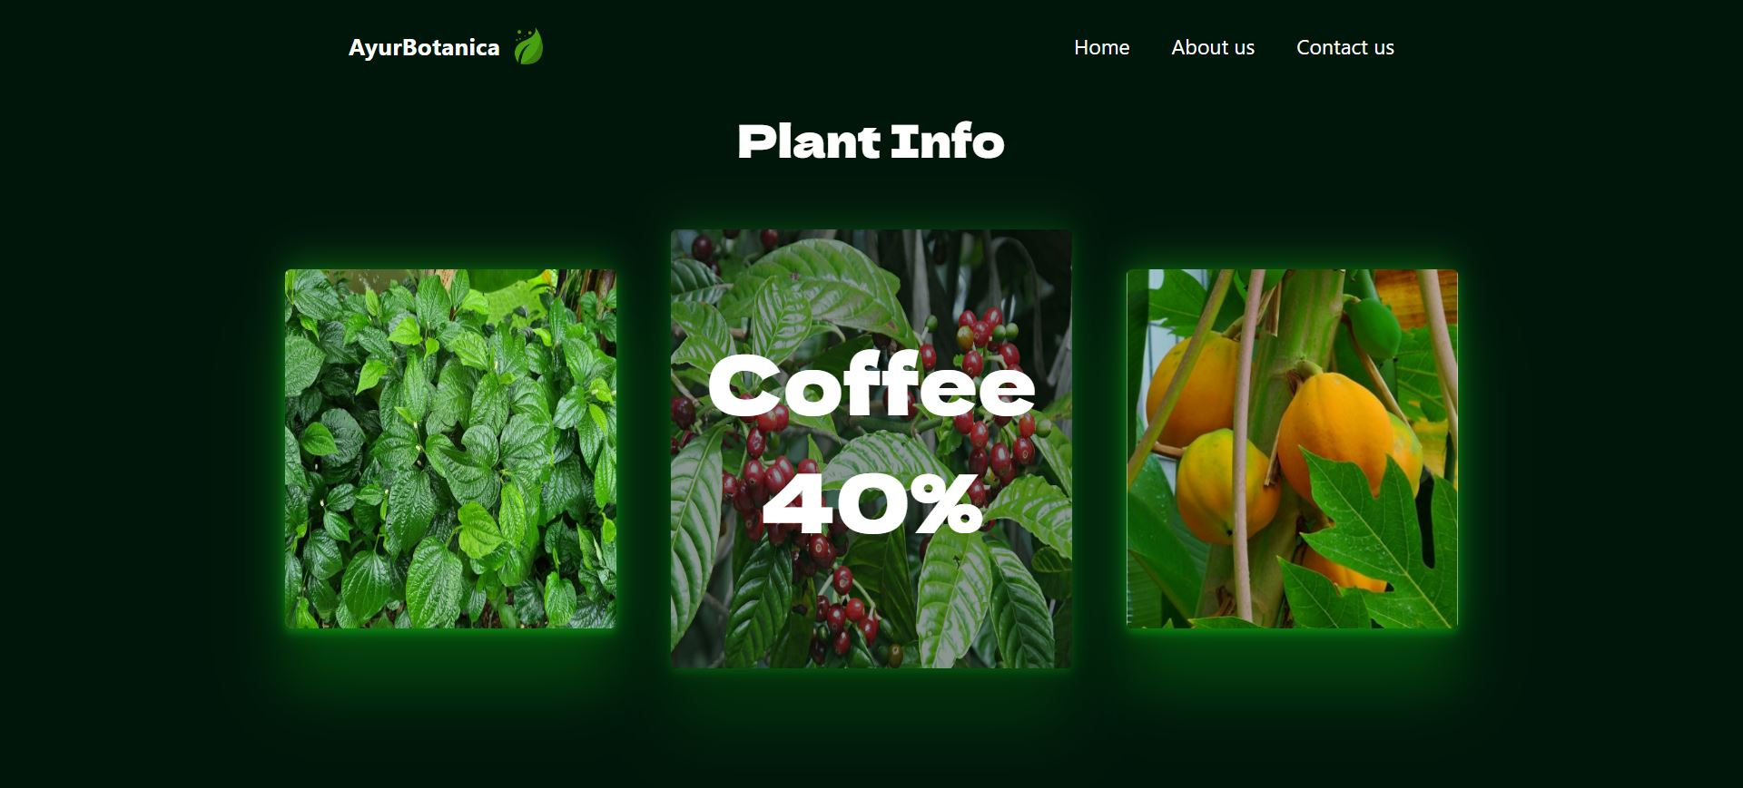

Slide 34
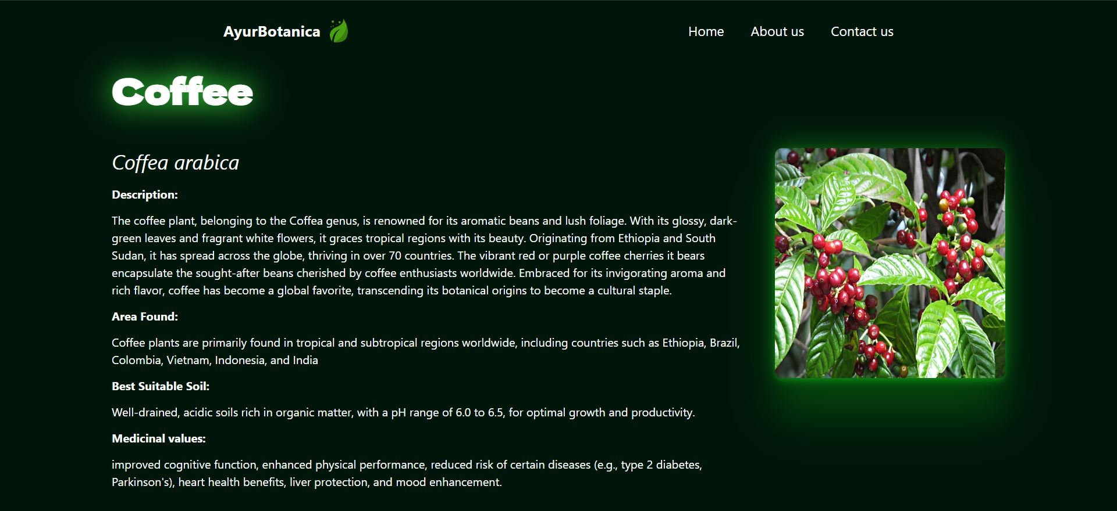

Slide 35


